Slide 1
Wine Quality prediction using logistic regression
Team members
Name: Sai kiran – 2520030125
Name : Harshith -- 2520030393

Slide 2
Abstract
Wine quality prediction is a machine learning project that aims to predict wine quality based on its physicochemical properties. The project uses the UCI Wine Quality dataset, which contains information about wine characteristics such as acidity, alcohol content, density, pH, and sulphates.
Two machine learning approaches are implemented: Binary Logistic Regression and Multinomial Logistic Regression. Binary Logistic Regression classifies wine as either Good or Bad, while Multinomial Logistic Regression predicts the exact wine quality rating from 3 to 9. The models are trained and evaluated using performance metrics such as accuracy, precision, recall, and F1-score.
The project aims to demonstrate how machine learning can analyze chemical properties and support wine quality assessment. A web-based interface can also be developed to allow users to enter wine properties and obtain predictions interactively.

Slide 3
Problem Statement
Wine quality assessment traditionally relies on laboratory testing and human expertise, which can be time-consuming and subjective. The challenge is to predict wine quality accurately using its physicochemical properties, such as acidity, alcohol content, pH, density, and sulphates.

Slide 4
Solution
.
This project aims to develop a machine learning system using Binary Logistic Regression and Multinomial Logistic Regression to predict wine quality. The binary model classifies wine as Good or Bad, while the multinomial model predicts the exact quality rating from 3 to 9. The system evaluates both models using accuracy, precision, recall, and F1-score to understand their performance.
The proposed system aims to provide a simple and efficient way to assess wine quality based on its chemical properties through an interactive web application.

Slide 5
Algorithms used
Binary Logistic Regression Purpose: Classifies wine into two categories: Good (1) or Bad (0). Type: Binary classification. Working: Calculates the probability that a wine belongs to the Good category and classifies it based on a threshold.
Multinomial Logistic Regression Purpose: Predicts the exact wine quality rating from 3 to 9. Type: Multiclass classification. Working: Estimates the probabilities of the different quality ratings and predicts the most likely class.

Slide 6
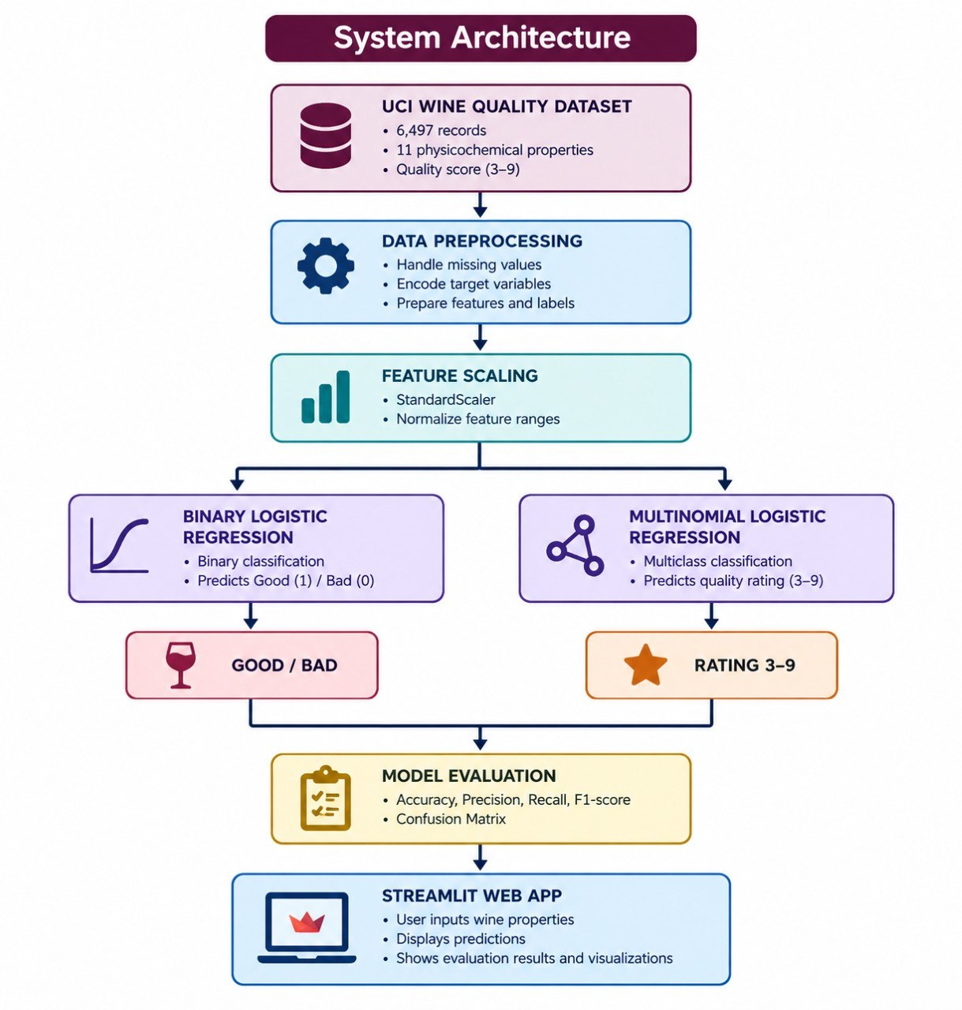
System architecture

Slide 7
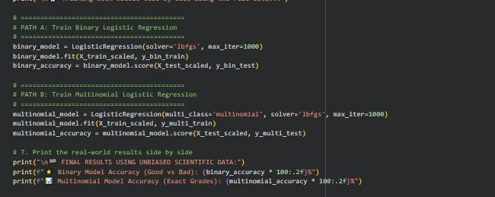
Training the Model

Slide 8
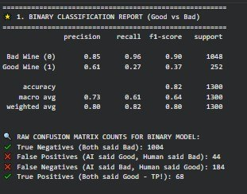
Binary Classification Report

Slide 9
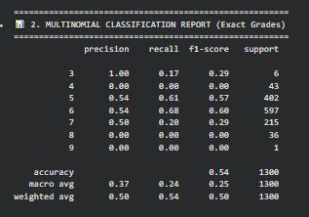
Binary Multinomial Classification Report

Slide 10
Thank You

